Slide 1

Data Mining & Business Intelligence
Module 6:Frequent Pattern Mining

Slide 2
Index -
Lecture 32-Mining Multilevel Association Rules | 4
Lecture 33 – Multidimensional Association Rules | 10
Lecture 34 – From Association Mining to Correlation Analysis, lift | 21
Lecture 35 –Constraint-Based Association Mining | 25

Slide 3
Lecture 32
Mining Multi-Level Associations

Slide 4
Mining Multi-Level Associations
A top_down, progressive deepening approach:
  First find high-level strong rules:
milk → bread [20%, 60%].
  Then find their lower-level “weaker” rules:
2% milk -→ wheat bread [6%, 50%].
Variations at mining multiple-level association rules.
  Level-crossed association rules:
  2% milk → Wonder wheat bread
  Association rules with multiple, alternative hierarchies:
  2% milk → Wonder bread
Lecture 32-Mining Multilevel Association

Slide 5
Multi-level Association: Uniform Support vs. Reduced Support
Two approaches of Multilevel association rule
Uniform Support: the same minimum support for all levels
  + One minimum support threshold. No need to examine itemsets containing any item whose ancestors do not have minimum support.
  – Lower level items do not occur as frequently. If support threshold
    too high ⇒ miss low level associations
    too low ⇒ generate too many high level associations
Reduced Support: reduced minimum support at lower levels
  There are 4 search strategies:
    Level-by-level independent
    Level-cross filtering by k-itemset
    Level-cross filtering by single item
    Controlled level-cross filtering by single item
Lecture 32-Mining Multilevel Association

Slide 6
Uniform Support
Multi-level mining with uniform support
Level 1
min_sup = 5%
Milk
[support = 10%]
Level 2
min_sup = 5%
2% Milk
[support = 6%]
Skim Milk
[support = 4%]
Lecture 32-Mining Multilevel Association

Slide 7
Reduced Support
Multi-level mining with reduced support
Level 1
min_sup = 5%
Milk
[support = 10%]
Level 2
min_sup = 3%
2% Milk
[support = 6%]
Skim Milk
[support = 4%]
Lecture 32-Mining Multilevel Association

Slide 8
Reduced Support Strategies
Level-by-level independent
  Full Breadth Search Method
  The parent node is checked whether it is frequent or not and based on that node is examined
Level-cross filtering by k-itemset
  The children of only frequent nodes are checked
Level-cross filtering by single item
  Find the frequent K-items at the parent level
  Only the k items at next level is checked
Controlled level-cross filtering by single item
  This is modified version of Level-cross filtering by single item
  Some minimum support threshold is set for for lower level.
  So the items which do not satisfy minimum support are checked for minimum support threshold this is also called “Level passage Threshold”
Lecture 32-Mining Multilevel Association

Slide 9
Lecture 33
Multidimensional Association Rules

Slide 10
Multi-Dimensional Association: Concepts
Single-dimensional rules: only one distinct predicate
    buys(X, “milk”) ⇒ buys(X, “bread”)
Multi-dimensional rules:  2 dimensions or predicates
  Inter-dimension association rules (no repeated predicates)
    age(X,”19-25”) ∧ occupation(X,“student”) ⇒ buys(X,“coke”)
  hybrid-dimension association rules (repeated predicates)
    age(X,”19-25”) ∧ buys(X, “popcorn”) ⇒ buys(X, “coke”)
Categorical Attributes
  finite number of possible values, no ordering among values. Example color ,brand.
Quantitative Attributes.
  numeric, implicit ordering among values
  Example-Age,Income.
Lecture 33 – Multidimensional Association Rules

Slide 11
Techniques for Mining MD Associations
Search for frequent k-predicate set:
  Example: {age, occupation, buys} is a 3-predicate set.
  Techniques can be categorized by how age are treated.
1. Using static discretization of quantitative attributes
  Quantitative attributes are statically discretized by using predefined concept hierarchies.
2. Quantitative association rules
  Quantitative attributes are dynamically discretized into “bins”based on the distribution of the data.
3. Distance-based association rules
  This is a dynamic discretization process that considers the distance between data points.
Lecture 33 – Multidimensional Association Rules

Slide 12
Static Discretization of Quantitative Attributes
Discretized prior to mining using concept hierarchy.
Numeric values are replaced by ranges.
In relational database, finding all frequent k-predicate sets will require k or k+1 table scans.
Data cube is well suited for mining.
The cells of an n-dimensional
  cuboid correspond to the
  predicate sets.
Mining from data cubes
can be much faster.
()
(age)
(income)
(buys)
(age, income)
(age,buys)
(income,buys)
(age,income,buys)
Lecture 33 – Multidimensional Association Rules

Slide 13
Quantitative Association Rules
Numeric attributes are dynamically discretized
  Such that the confidence or compactness of the rules mined is maximized.
2-D quantitative association rules: A_{quan1} ∧ A_{quan2} ⇒ A_{cat}
Cluster “adjacent”
  association rules
  to form general
  rules using a 2-D
  grid.
Example:
age(X,”30-34”) ∧ income(X,”24K - 48K”)
⇒ buys(X,”high resolution TV”)
Lecture 33 – Multidimensional Association Rules

Slide 14

ARCS (Association Rule Clustering System)
How does ARCS work?
1. Binning(Equi Width Binning)-same interval size.
2. Find frequent predicate set-Satisfy Minimum support and confidence
3. Clustering-Strong association rule is mapped to 2 D grid
age(X,”30-34”) ∧ income(X,”24K - 48K”)
⇒ buys(X,”high resolution TV”)
Lecture 33 – Multidimensional Association Rules

Slide 15
Limitations of ARCS
Only quantitative attributes on LHS of rules.
Only 2 attributes on LHS. (2D limitation)
.
Lecture 33 – Multidimensional Association Rules

Slide 16
Mining Distance-based Association Rules
Distance-based partitioning, more meaningful discretization considering
Two Steps
  density/number of points in an interval
  “closeness” of points in an interval
  The resultant rule of this method must satisfy:
  Cluster in the rule antecedent are strongly associated with cluster of the rules in consequent.
  Clusters in the antecedent occur together
  Clusters in the consequent occur together
Lecture 33 – Multidimensional Association Rules

Slide 17
Interestingness Measurements
Objective measures
  Two popular measurements:
  support; and
  confidence
Subjective measures (Silberschatz & Tuzhilin, KDD95)
  A rule (pattern) is interesting if
  it is unexpected (surprising to the user); and/or
  actionable (the user can do something with it)
Lecture 33 – Multidimensional Association Rules

Slide 18
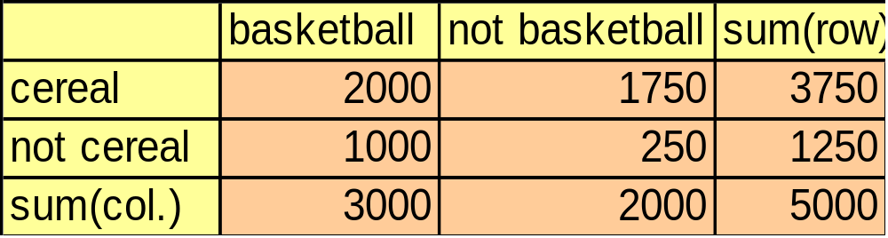
Criticism to Support and Confidence
Example 1: (Aggarwal & Yu, PODS98)
  Among 5000 students
    3000 play basketball
    3750 eat cereal
    2000 both play basket ball and eat cereal
  play basketball ⇒ eat cereal [40%, 66.7%] is misleading because the overall percentage of students eating cereal is 75% which is higher than 66.7%.
  play basketball ⇒ not eat cereal [20%, 33.3%] is far more accurate, although with lower support and confidence
Lecture 33 – Multidimensional Association Rules

Slide 19
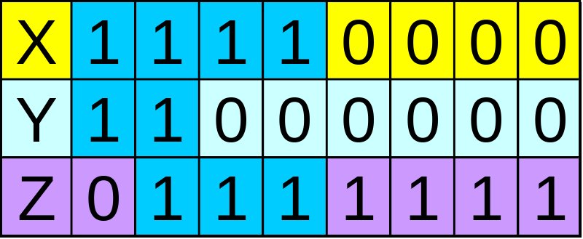
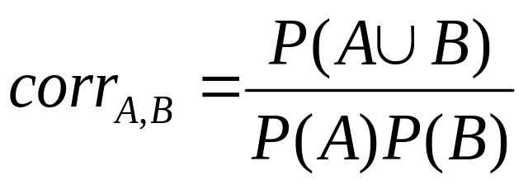
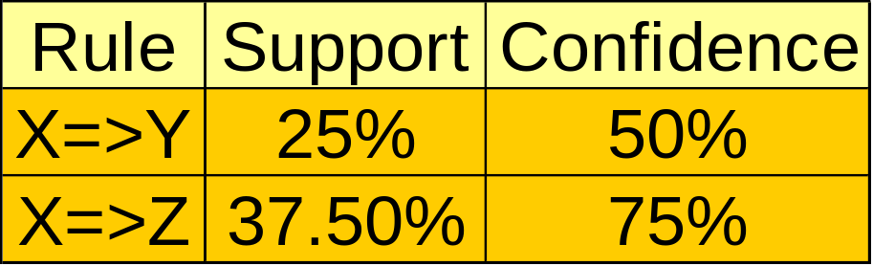
Criticism to Support and Confidence (Cont.)
Example 2:
  X and Y: positively correlated,
  X and Z, negatively related
  support and confidence of
  X=>Z dominates
We need a measure of dependent or correlated events
P(B|A)/P(B) is also called the lift of rule A => B
Lecture 33 – Multidimensional Association Rules

Slide 20
Lecture 34
From Association Mining to Correlation Analysis, lift,

Slide 21
From Association Mining to Correlation analysis
The support and confidence measures are insufficient at filtering out uninteresting association rules.
To tackle this weakness, a correlation measure can be used to augment the support–confidence framework for association rules.
This leads to correlation rules of the form
A →B [support, confidence, correlation].
That is, a correlation rule is measured not only by its support and confidence but also by the correlation between itemsets A and B.
There are many different correlation measures from which to choose
Lecture 34-From Association Mining to Correlation analysis

Slide 22
Interestingness Measure: Correlations (Lift)
Lift is a simple correlation measure that is given as follows.
The occurrence of itemset
A is independent of the occurrence of itemset B if P.A [B/ D P.A/P.B/; otherwise,
itemsets A and B are dependent and correlated as events. This definition can easily be
extended to more than two itemsets. The lift between the occurrence of A and B can be
measured by computing
Lecture 34-From Association Mining to Correlation analysis

Slide 23



Interestingness Measure: Correlations (Lift)
play basketball ⇒ eat cereal [40%, 66.7%] is misleading
  The overall % of students eating cereal is 75% > 66.7%.
play basketball ⇒ not eat cereal [20%, 33.3%] is more accurate, although with lower support and confidence
Measure of dependent/correlated events: lift
 | Basketball | Not basketball | Sum (row)
Cereal | 2000 | 1750 | 3750
Not cereal | 1000 | 250 | 1250
Sum(col.) | 3000 | 2000 | 5000
Lecture 34-From Association Mining to Correlation analysis

Slide 24
Lecture 35
Constraint-Based Association
Mining.

Slide 25
Constraint-Based Mining
Interactive, exploratory mining giga-bytes of data?
  Could it be real? — Making good use of constraints!
What kinds of constraints can be used in mining?
  Knowledge type constraint: classification, association, etc.
  Data constraint: SQL-like queries
    Find product pairs sold together in Vancouver in Dec.’98.
  Dimension/level constraints:
    in relevance to region, price, brand, customer category.
  Rule constraints
    small sales (price < $10) triggers big sales (sum > $200).
  Interestingness constraints:
    strong rules (min_support ≥ 3%, min_confidence ≥ 60%).
Lecture 35 –Constraint-Based Association Mining

Slide 26
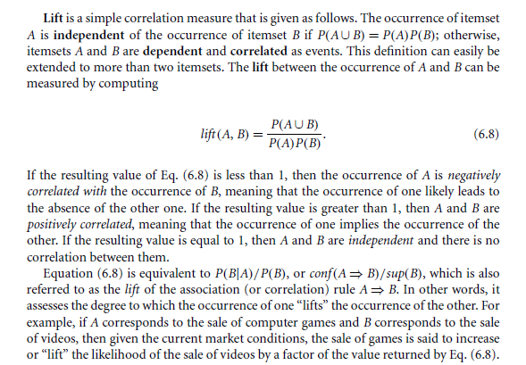
Lecture 35 –Constraint-Based Association Mining

Slide 27
Rule Constraints in Association Mining
Two kind of rule constraints:
  Rule form constraints: meta-rule guided mining.
    P(x, y) ^ Q(x, w) -→ takes(x, “database systems”).
  Rule (content) constraint: constraint-based query
    sum(LHS) < 100 ^ min(LHS) > 20 ^ count(LHS) > 3 ^ sum(RHS) > 1000
1-variable vs. 2-variable constraints (Lakshmanan, et al. SIGMOD’99):
  1-var: A constraint confining only one side (L/R) of the rule, e.g., as shown above.
  2-var: A constraint confining both sides (L and R).
    sum(LHS) < min(RHS) ^ max(RHS) < 5* sum(LHS)
Lecture 35 –Constraint-Based Association Mining

Slide 28
Constrained Association Query Optimization Problem
Given a CAQ = { (S1, S2) | C }, the algorithm should be :
  sound: It only finds frequent sets that satisfy the given constraints C
  complete: All frequent sets satisfy the given constraints C are found
A naïve solution:
  Apply Apriori for finding all frequent sets, and then to test them for constraint satisfaction one by one.
Our approach:
  Comprehensive analysis of the properties of constraints and try to push them as deeply as possible inside the frequent set computation.’
Lecture 35 –Constraint-Based Association Mining

Slide 29

Thank You

